Slide 1
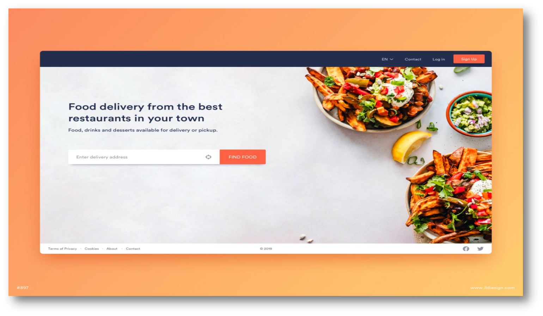
FOOD DELIVERY SYSTEM

Slide 2
DEVELOPER NAME
Name | Enrollment No
Harsh Khokhar | 2104030100353
Griva Kakadiya | 2104030100320
Chirag Koshti | 2104030100366

Slide 3
OBJECTIVE
Easy to food order
Customize food
View all reports
Safe and Easy payment
Delivery food order

Slide 4
PURPOSE
The purpose of the system is customer can view menu list according to the time of delivery he desires and reserve meal for that specific time, and at the management side the staff is allowed to edit information regarding menu list, price, assigning cook, maintain information regarding the orders placed, etc. The customer can reserve the table earlier for future and book the order what he desires.

Slide 5
SYSTEM REQUIREMENT
HARDWARE & SOFTWARE REQUIREMENTS :-
Hardware :
RAM : 2 GB or Higher
Hard Disk : 320 GB
SOFTWARE :
Tools : Sublime Text Editor
Server : XAMPP SERVER (Open source)

Slide 6
SYSTEM REQUIREMENT
Front End :
HTML , CSS , JAVA SCRIPT , BOOTSTRAP
Back End :
Technology : PHP
Database : MYSQL

Slide 7
Thank You

